Slide 1
Decision Making
Decision
  Making a choice from two or more alternatives.
The Decision-Making Process
  Identifying a problem and decision criteria and allocating weights to the criteria.
  Developing, analyzing, and selecting an alternative that can resolve the problem.
  Implementing the selected alternative.
  Evaluating the decision’s effectiveness.
© 2007 Prentice Hall, Inc. All rights reserved.
6–<number>

Slide 2
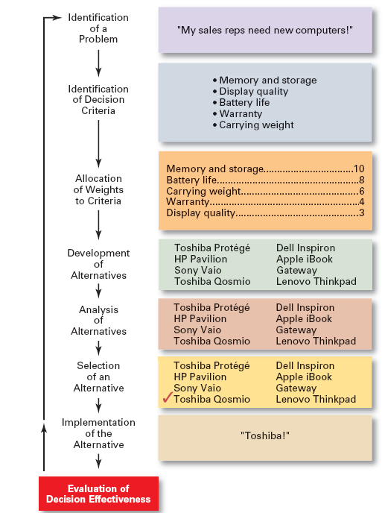
Exhibit 6–1
The Decision-Making Process
© 2007 Prentice Hall, Inc. All rights reserved.
6–<number>

Slide 3
Step 1: Identifying the Problem
Problem
  A discrepancy between an existing and desired state of affairs.
Characteristics of Problems
  A problem becomes a problem when a manager becomes aware of it.
  There is pressure to solve the problem.
  The manager must have the authority, information, or resources needed to solve the problem.
© 2007 Prentice Hall, Inc. All rights reserved.
6–<number>

Slide 4
Step 2: Identifying Decision Criteria
Decision criteria are factors that are important (relevant) to resolving the problem.
  Costs that will be incurred (investments required)
  Risks likely to be encountered (chance of failure)
  Outcomes that are desired (growth of the firm)
Step 3: Allocating Weights to the Criteria
Decision criteria are not of equal importance:
  Assigning a weight to each item places the items in the correct priority order of their importance in the decision making process.
© 2007 Prentice Hall, Inc. All rights reserved.
6–<number>

Slide 5
Exhibit 6–2 Criteria and Weights for Computer Replacement Decision
Criterion Weight
Memory and Storage 10
Battery life 8
Carrying Weight 6
Warranty 4
Display Quality 3
© 2007 Prentice Hall, Inc. All rights reserved.
6–<number>

Slide 6
Step 4: Developing Alternatives
Identifying viable alternatives
  Alternatives are listed (without evaluation) that can resolve the problem.
Step 5: Analyzing Alternatives
Appraising each alternative’s strengths and weaknesses
  An alternative’s appraisal is based on its ability to resolve the issues identified in steps 2 and 3.
© 2007 Prentice Hall, Inc. All rights reserved.
6–<number>

Slide 7
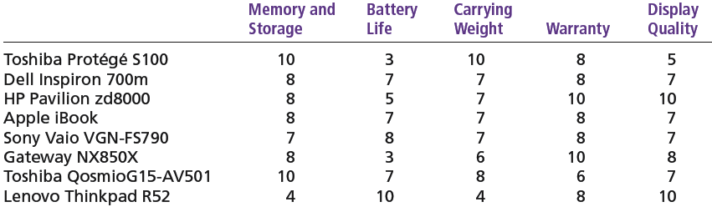
Exhibit 6–3 Assessed Values of Laptop Computers Using Decision Criteria
© 2007 Prentice Hall, Inc. All rights reserved.
6–<number>

Slide 8
Step 6: Selecting an Alternative
Choosing the best alternative
  The alternative with the highest total weight is chosen.
Step 7: Implementing the Alternative
Putting the chosen alternative into action.
  Conveying the decision to and gaining commitment from those who will carry out the decision.
© 2007 Prentice Hall, Inc. All rights reserved.
6–<number>

Slide 9
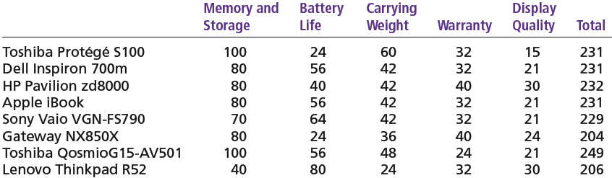
Exhibit 6–4 Evaluation of Laptop Alternatives Against Weighted Criteria
© 2007 Prentice Hall, Inc. All rights reserved.
6–<number>

Slide 10
Step 8: Evaluating the Decision’s Effectiveness
The soundness of the decision is judged by its outcomes.
  How effectively was the problem resolved by outcomes resulting from the chosen alternatives?
  If the problem was not resolved, what went wrong?
© 2007 Prentice Hall, Inc. All rights reserved.
6–<number>

Slide 11
Making Decisions
Rationality
  Managers make consistent, value-maximizing choices with specified constraints.
  Assumptions are that decision makers:
    Are perfectly rational, fully objective, and logical.
    Have carefully defined the problem and identified all viable alternatives.
    Have a clear and specific goal
    Will select the alternative that maximizes outcomes in the organization’s interests rather than in their personal interests.
© 2007 Prentice Hall, Inc. All rights reserved.
6–<number>

Slide 12
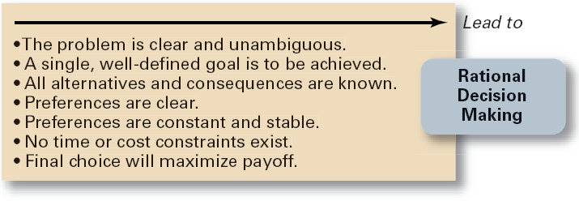
Exhibit 6–6 Assumptions of Rationality
© 2007 Prentice Hall, Inc. All rights reserved.
6–<number>

Slide 13
Making Decisions (cont’d)
Bounded Rationality
  Managers make decisions rationally, but are limited (bounded) by their ability to process information.
  Assumptions are that decision makers:
    Will not seek out or have knowledge of all alternatives
    Will satisfice—choose the first alternative encountered that satisfactorily solves the problem—rather than maximize the outcome of their decision by considering all alternatives and choosing the best.
  Influence on decision making
    Escalation of commitment: an increased commitment to a previous decision despite evidence that it may have been wrong.
© 2007 Prentice Hall, Inc. All rights reserved.
6–<number>

Slide 14
The Role of Intuition
Intuitive decision making
  Making decisions on the basis of experience, feelings, and accumulated judgment.
© 2007 Prentice Hall, Inc. All rights reserved.
6–<number>

Slide 15
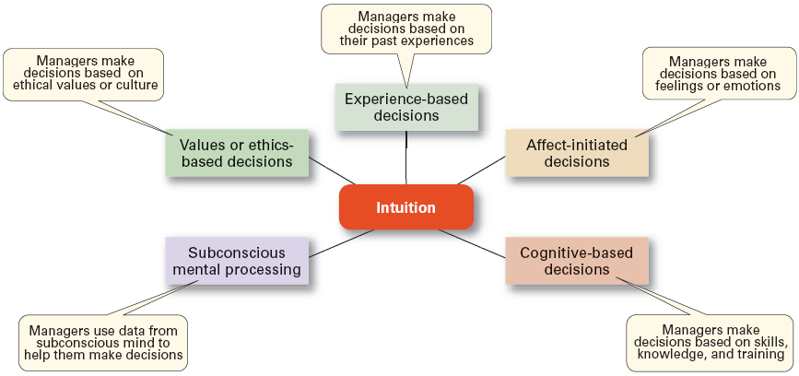
Exhibit 6–7 What is Intuition?
Source: Based on L. A. Burke and M. K. Miller, “Taking the Mystery Out of Intuitive Decision Making,” Academy of Management Executive, October 1999, pp. 91–99.
© 2007 Prentice Hall, Inc. All rights reserved.
6–<number>

Slide 16
Types of Problems and Decisions
Structured Problems
  Involve goals that clear.
  Are familiar (have occurred before).
  Are easily and completely defined—information about the problem is available and complete.
Programmed Decision
  A repetitive decision that can be handled by a routine approach.
© 2007 Prentice Hall, Inc. All rights reserved.
6–<number>

Slide 17
Types of Programmed Decisions
Policy
  A general guideline for making a decision about a structured problem.
Procedure
  A series of interrelated steps that a manager can use to respond (applying a policy) to a structured problem.
Rule
  An explicit statement that limits what a manager or employee can or cannot do.
© 2007 Prentice Hall, Inc. All rights reserved.
6–<number>

Slide 18
Policy, Procedure, and Rule Examples
Policy
  Accept all customer-returned merchandise.
Procedure
  Follow all steps for completing merchandise return documentation.
Rules
  Managers must approve all refunds over $50.00.
  No credit purchases are refunded for cash.
© 2007 Prentice Hall, Inc. All rights reserved.
6–<number>

Slide 19
Problems and Decisions (cont’d)
Unstructured Problems
  Problems that are new or unusual and for which information is ambiguous or incomplete.
  Problems that will require custom-made solutions.
Nonprogrammed Decisions
  Decisions that are unique and nonrecurring.
  Decisions that generate unique responses.
© 2007 Prentice Hall, Inc. All rights reserved.
6–<number>

Slide 20
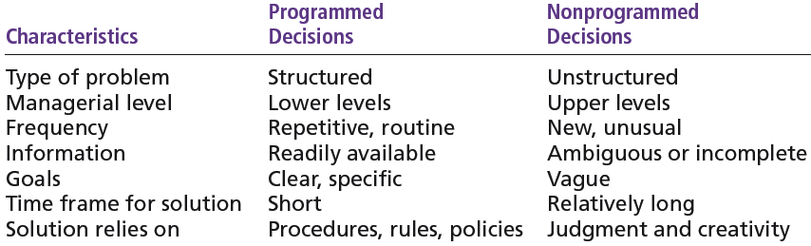
Exhibit 6–8 Programmed versus Nonprogrammed Decisions
© 2007 Prentice Hall, Inc. All rights reserved.
6–<number>

Slide 21
Decision-Making Conditions
Certainty
  A situation in which a manager can make an accurate decision because the outcome of every alternative choice is known.
Risk
  A situation in which the manager is able to estimate the likelihood (probability) of outcomes that result from the choice of particular alternatives.
© 2007 Prentice Hall, Inc. All rights reserved.
6–<number>

Slide 22
Decision-Making Conditions
Uncertainty
  Limited information prevents estimation of outcome probabilities for alternatives associated with the problem and may force managers to rely on intuition, hunches, and “gut feelings”.
    Maximax: the optimistic manager’s choice to maximize the maximum payoff
    Maximin: the pessimistic manager’s choice to maximize the minimum payoff
    Minimax: the manager’s choice to minimize maximum regret.
© 2007 Prentice Hall, Inc. All rights reserved.
6–<number>

Slide 23
Decision-Making Styles
Dimensions of Decision-Making Styles
  Ways of thinking
    Rational, orderly, and consistent
    Intuitive, creative, and unique
  Tolerance for ambiguity
    Low tolerance: require consistency and order
    High tolerance: multiple thoughts simultaneously
© 2007 Prentice Hall, Inc. All rights reserved.
6–<number>

Slide 24
Decision-Making Styles (cont’d)
Types of Decision Makers
  Directive
    Use minimal information and consider few alternatives.
  Analytic
    Make careful decisions in unique situations.
  Conceptual
    Maintain a broad outlook and consider many alternatives in making decisions.
  Behavioral
    Avoid conflict by working well with others and being receptive to suggestions.
© 2007 Prentice Hall, Inc. All rights reserved.
6–<number>

Slide 25
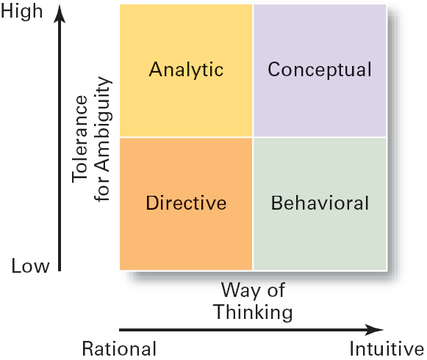
Exhibit 6–12 Decision-Making Matrix
© 2007 Prentice Hall, Inc. All rights reserved.
6–<number>

Slide 26
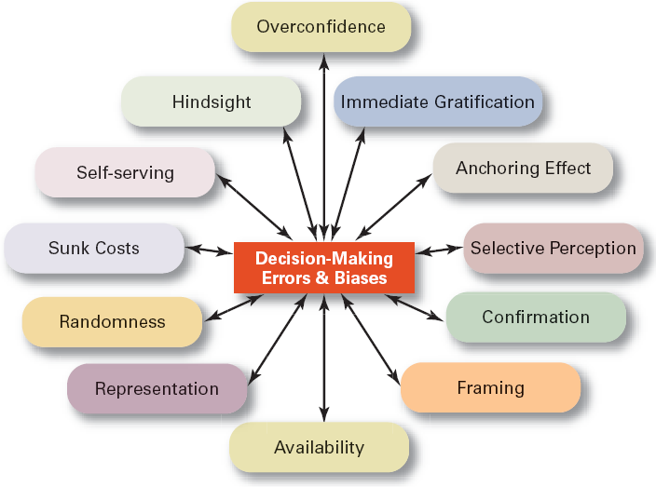
Exhibit 6–13 Common Decision-Making Errors and Biases
© 2007 Prentice Hall, Inc. All rights reserved.
6–<number>

Slide 27
Decision-Making Biases and Errors
Heuristics
  Using “rules of thumb” to simplify decision making.
Overconfidence Bias
  Holding unrealistically positive views of one’s self and one’s performance.
Immediate Gratification Bias
  Choosing alternatives that offer immediate rewards and that to avoid immediate costs.
© 2007 Prentice Hall, Inc. All rights reserved.
6–<number>

Slide 28
Decision-Making Biases and Errors (cont’d)
Anchoring Effect
  Fixating on initial information and ignoring subsequent information.
Selective Perception Bias
  Selecting organizing and interpreting events based on the decision maker’s biased perceptions.
Confirmation Bias
  Seeking out information that reaffirms past choices and discounting contradictory information.
© 2007 Prentice Hall, Inc. All rights reserved.
6–<number>

Slide 29
Decision-Making Biases and Errors (cont’d)
Framing Bias
  Selecting and highlighting certain aspects of a situation while ignoring other aspects.
Availability Bias
  Losing decision-making objectivity by focusing on the most recent events.
Representation Bias
  Drawing analogies and seeing identical situations when none exist.
Randomness Bias
  Creating unfounded meaning out of random events.
© 2007 Prentice Hall, Inc. All rights reserved.
6–<number>

Slide 30
Decision-Making Biases and Errors (cont’d)
Sunk Costs Errors
  Forgetting that current actions cannot influence past events and relate only to future consequences.
Self-Serving Bias
  Taking quick credit for successes and blaming outside factors for failures.
Hindsight Bias
  Mistakenly believing that an event could have been predicted once the actual outcome is known (after-the-fact).
© 2007 Prentice Hall, Inc. All rights reserved.
6–<number>

Slide 31
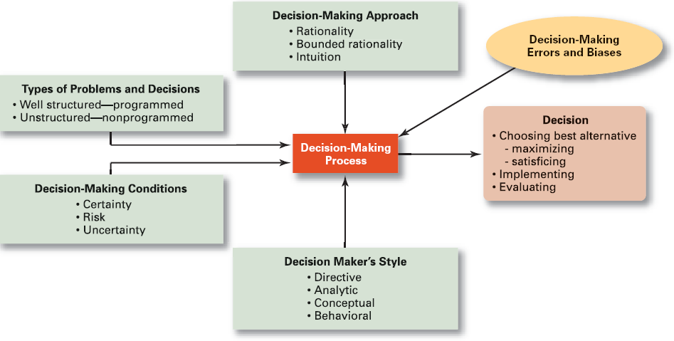
Exhibit 6–14 Overview of Managerial Decision Making
© 2007 Prentice Hall, Inc. All rights reserved.
6–<number>

Slide 32
What Is Planning?
Planning
  A primary managerial activity that involves:
    Defining the organization’s goals
    Establishing an overall strategy for achieving those goals
    Developing plans for organizational work activities.
  Types of planning
    Informal: not written down, short-term focus; specific to an organizational unit.
    Formal: written, specific, and long-term focus, involves shared goals for the organization.
© 2007 Prentice Hall, Inc. All rights reserved.
7–<number>

Slide 33

Why Do Managers Plan?
Purposes of Planning
  Provides direction
  Reduces uncertainty
  Minimizes waste and redundancy
  Sets the standards for controlling
© 2007 Prentice Hall, Inc. All rights reserved.
7–<number>

Slide 34
How Do Managers Plan?
Elements of Planning
  Goals (also Objectives)
    Desired outcomes for individuals, groups, or entire organizations
    Provide direction and evaluation performance criteria
    SMART- Specific, Measurable, Attainable/Achievable, Realistic, Timebound
  Plans
    Documents that outline how goals are to be accomplished
    Describe how resources are to be allocated and establish activity schedules
© 2007 Prentice Hall, Inc. All rights reserved.
7–<number>

Slide 35
Types of Goals
Financial Goals
  Are related to the expected internal financial performance of the organization.
Strategic Goals
  Are related to the performance of the firm relative to factors in its external environment (e.g., competitors).
Stated Goals versus Real Goals
  Broadly-worded official statements of the organization (intended for public consumption) that may be irrelevant to its real goals (what actually goes on in the organization).
© 2007 Prentice Hall, Inc. All rights reserved.
7–<number>

Slide 36
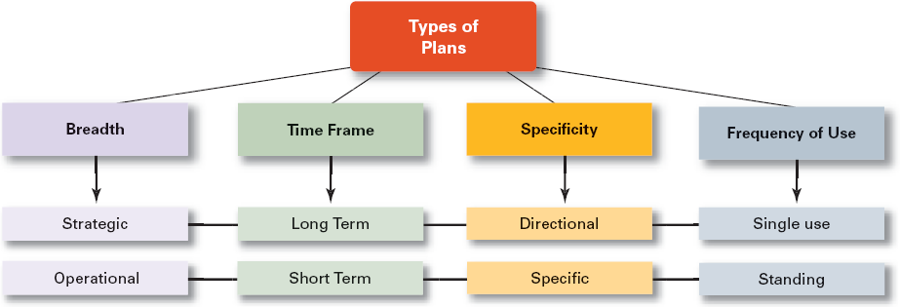
Exhibit 7–2 Types of Plans
© 2007 Prentice Hall, Inc. All rights reserved.
7–<number>

Slide 37
Types of Plans
Strategic Plans
  Apply to the entire organization.
  Establish the organization’s overall goals.
  Seek to position the organization in terms of its environment.
  Cover extended periods of time.
Operational Plans
  Specify the details of how the overall goals are to be achieved.
  Cover short time period.
© 2007 Prentice Hall, Inc. All rights reserved.
7–<number>

Slide 38
Types of Plans (cont’d)
Long-Term Plans
  Plans with time frames extending beyond three years
Short-Term Plans
  Plans with time frames on one year or less
Specific Plans
  Plans that are clearly defined and leave no room for interpretation
Directional Plans
  Flexible plans that set out general guidelines, provide focus, yet allow discretion in implementation.
© 2007 Prentice Hall, Inc. All rights reserved.
7–<number>

Slide 39
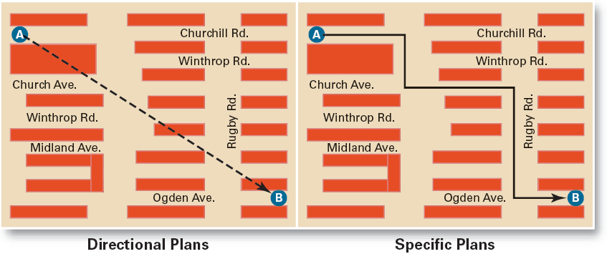
Exhibit 7–3 Specific Versus Directional Plans
© 2007 Prentice Hall, Inc. All rights reserved.
7–<number>

Slide 40
Types of Plans (cont’d)
Single-Use Plan
  A one-time plan specifically designed to meet the need of a unique situation.
Standing Plans
  Ongoing plans that provide guidance for activities performed repeatedly.
© 2007 Prentice Hall, Inc. All rights reserved.
7–<number>

Slide 41
Steps in Goal Setting
Review the organization’s mission statement.
  Do goals reflect the mission?
Evaluate available resources.
  Are resources sufficient to accomplish the mission?
Determine goals individually or with others.
  Are goals specific, measurable, and timely?
Write down the goals and communicate them.
  Is everybody on the same page?
Review results and whether goals are being met.
  What changes are needed in mission, resources, or goals?
© 2007 Prentice Hall, Inc. All rights reserved.
7–<number>

Slide 42
Developing Plans
Contingency Factors in A Manager’s Planning
  Manager’s level in the organization
    Strategic plans at higher levels
    Operational plans at lower levels
  Degree of environmental uncertainty
    Stable environment: specific plans
    Dynamic environment: specific but flexible plans
  Length of future commitments
    Commitment Concept: current plans affecting future commitments must be sufficiently long-term to meet those commitments.
© 2007 Prentice Hall, Inc. All rights reserved.
7–<number>

Slide 43
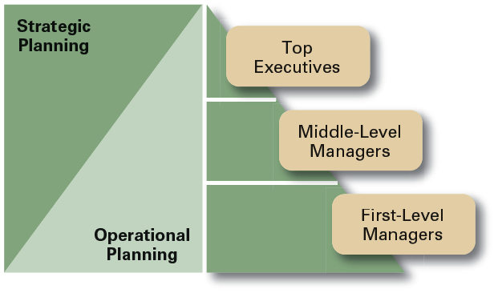
Exhibit 7–7 Planning in the Hierarchy of Organizations
© 2007 Prentice Hall, Inc. All rights reserved.
7–<number>

